Slide 1


Amazon Fine Food Reviews
Domain: Sentimental Analysis (Natural Language Processing)
Group 2
1. Gowtham Chakri Mallepaka 2.Javadbay Khalilzade 3. Meghana Udiga

Slide 2

Table of Contents
1. Introduction
2. Scope & Objectives
3. Dataset
4. Literature Review
5. Analysis & Modelling
6. Results
7. Conclusion

Slide 3

Introduction
Analyzing the Amazon fine food reviews dataset in the Business Analytics Capstone Project
Identifying patterns and trends in customer sentiment and product insights
Exploring consumer preferences and assessing product success
Providing actionable ideas for improving business strategies

Slide 4
Scope & Objectives
Scope:
Providing insights for product improvement, decision-making, and customer engagement
Enhancing understanding of customer sentiments for merchants and producers
Objectives:
Analyzing the Amazon fine food reviews dataset in the Business Analytics Capstone Project
Identifying patterns and trends in customer sentiment and product insights
Exploring consumer preferences and assessing product success
Providing actionable ideas for improving business strategies

Slide 5
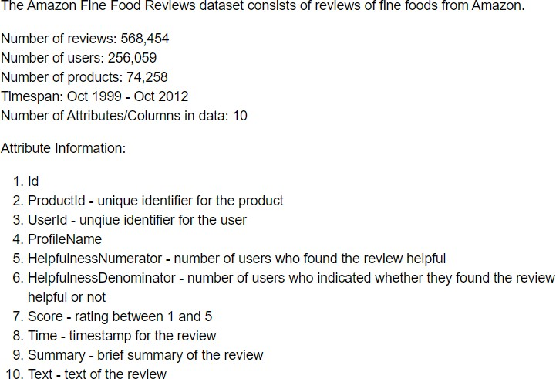
Dataset

Slide 6

Literature Review (Merits)
Innovative Approaches: Each paper presents innovative approaches to sentiment analysis, introducing new techniques to enhance the accuracy and understanding of customer sentiments.
Diverse Perspectives: The studies explore various aspects of sentiment analysis, such as knowledge graph integration, cross-lingual adaptation, aspect-based analysis, and multi-modal approaches, providing a comprehensive understanding of sentiment analysis methodologies.
Expanded Applications: The research papers contribute to the expansion of sentiment analysis applications, exploring social media reviews, cross-lingual contexts, and fine-grained sentiments, broadening the scope of sentiment analysis research.

Slide 7

Literature Review (Demerits)
Data Availability and Quality: Some papers may face challenges related to data availability and quality, especially when dealing with cross-lingual datasets and fine-grained sentiment annotations, which can impact the robustness of the analysis.
Resource and Expertise Requirements: The application of certain advanced techniques may require significant computational resources and expertise, making them less accessible to researchers with limited resources or expertise. This limitation could hinder the widespread adoption and replication of the research findings.

Slide 8
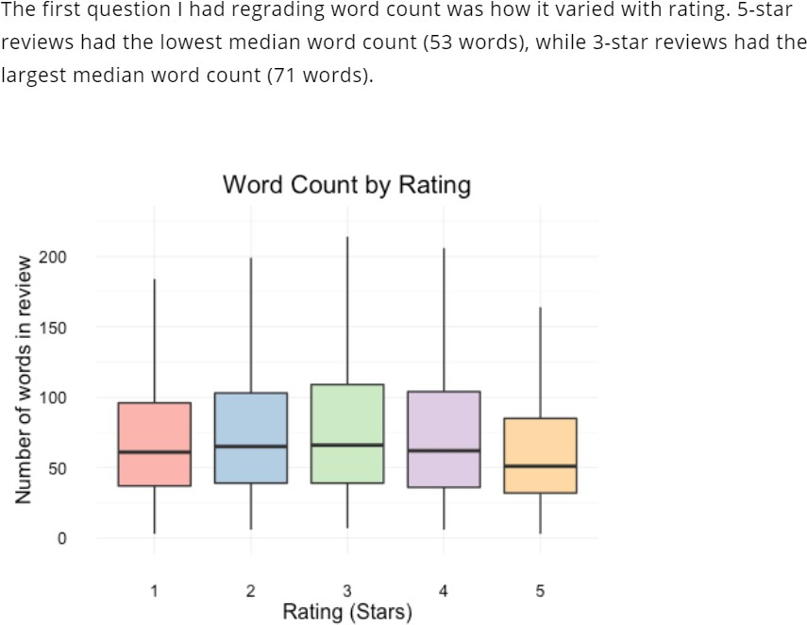
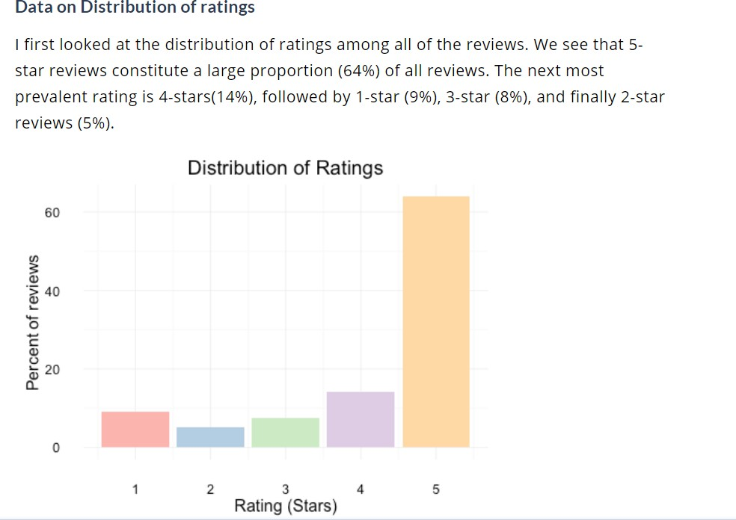
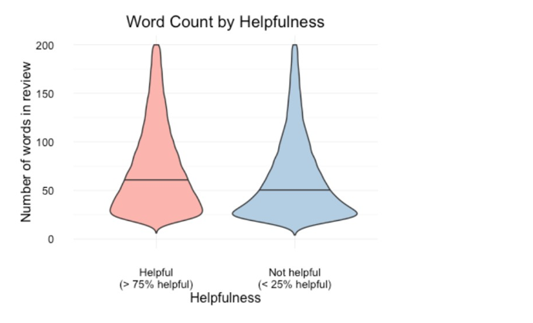
Analysis & Modelling

Slide 9

Modelling
Models Used:
1. KNN (K- Nearest Neighbor)
2. Logistic Regression
3. SVM
4. Random Forest

Slide 10
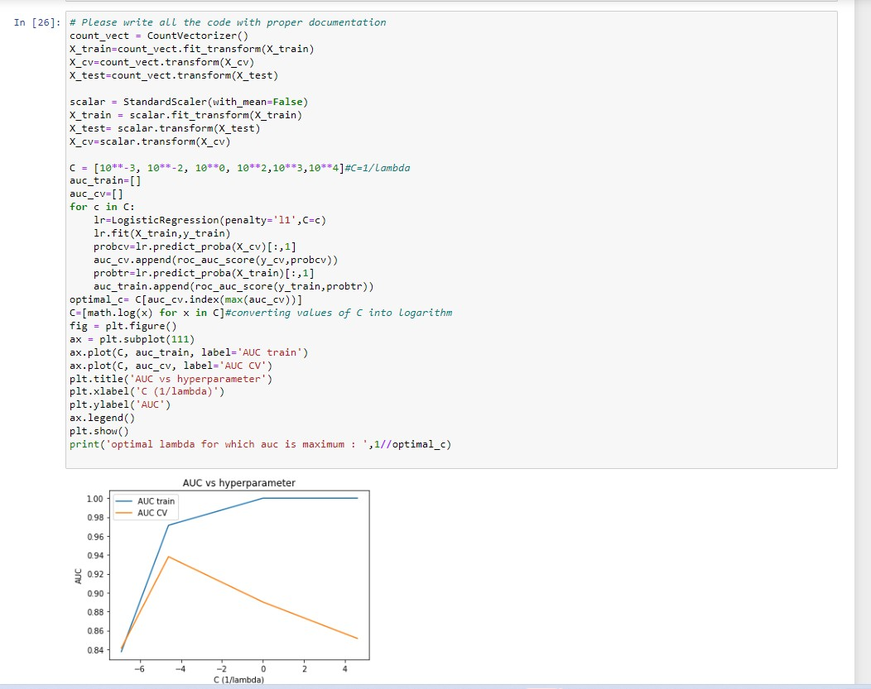
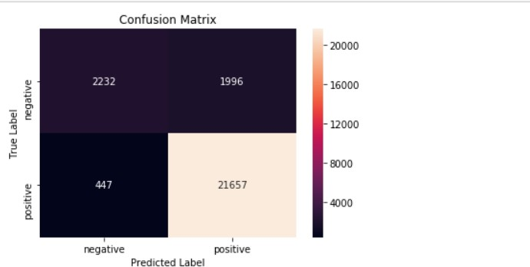
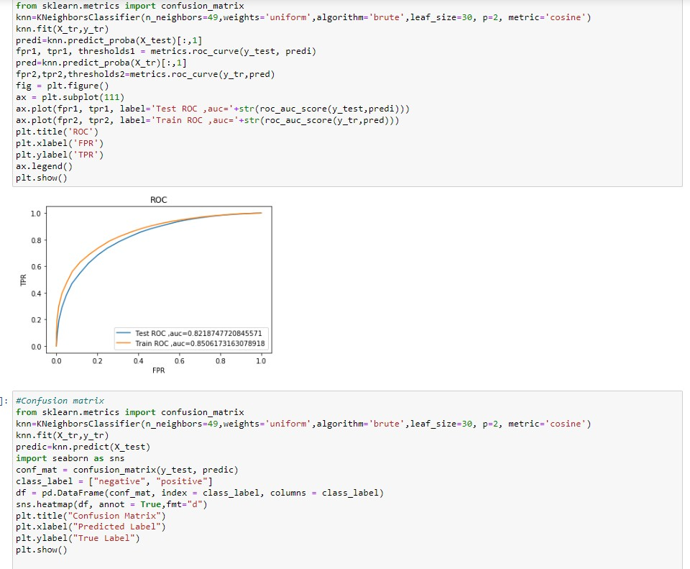
Logistic Regression

Slide 11
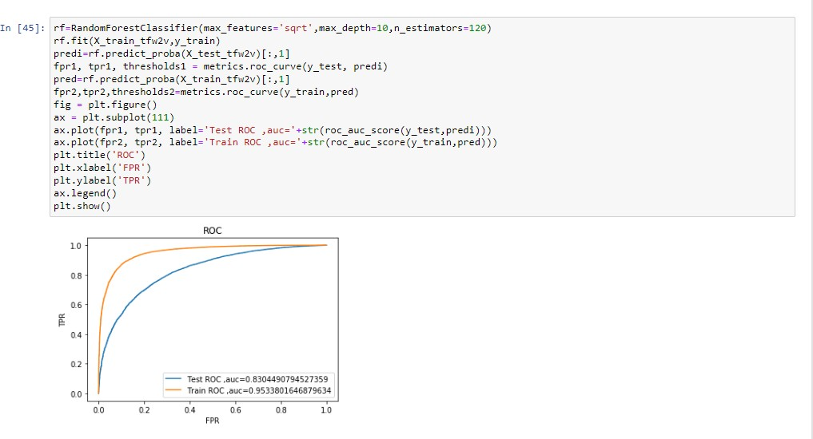
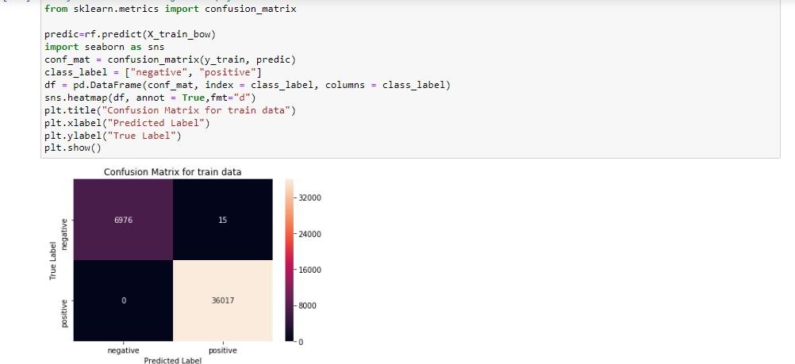
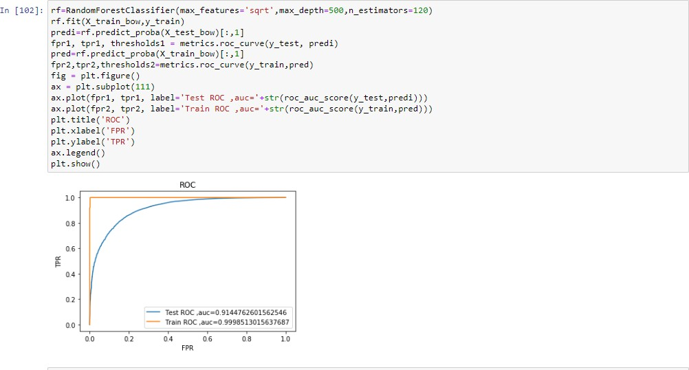
Random Forest

Slide 12
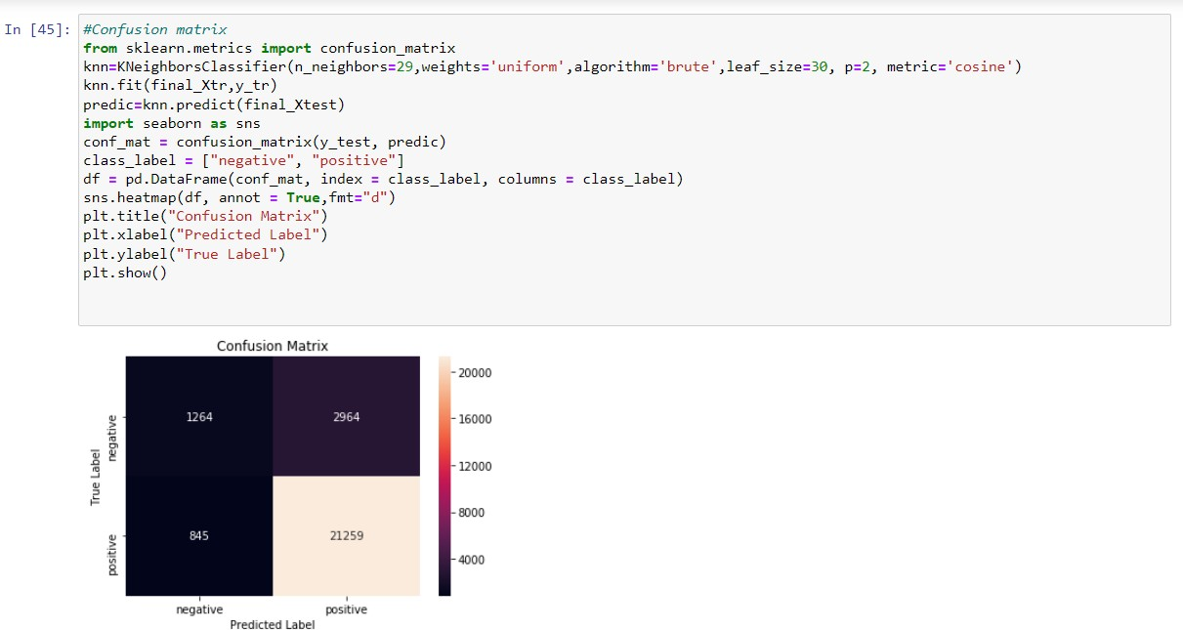
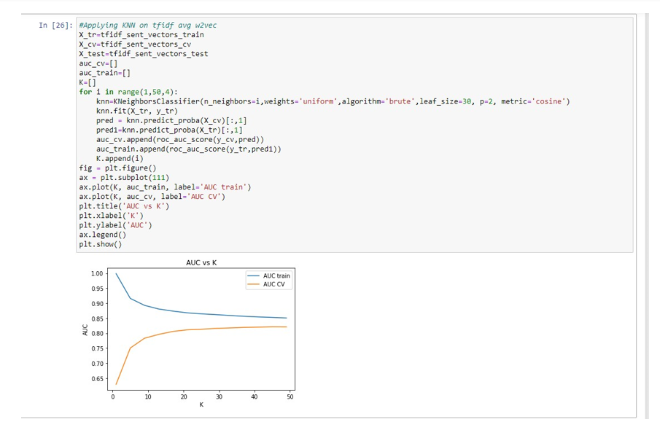
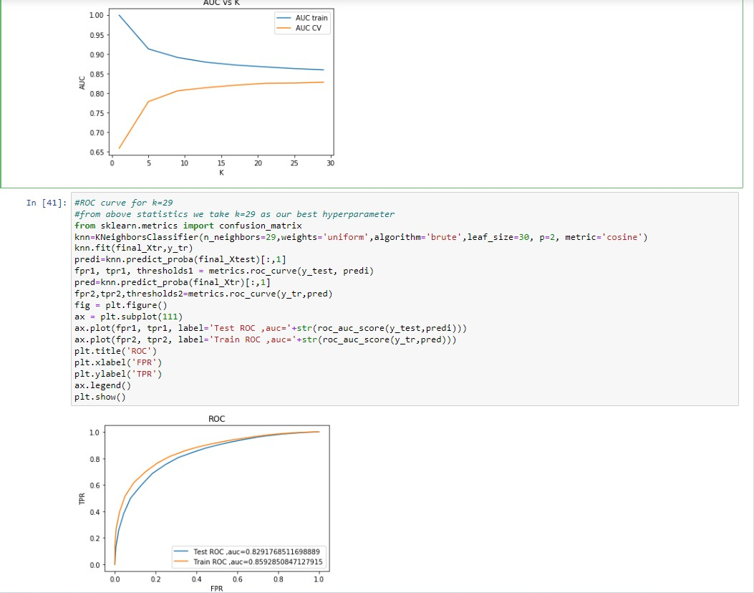
KNN (K- Nearest Neighbor)

Slide 13
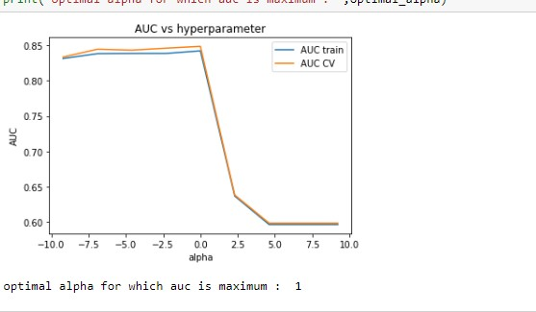
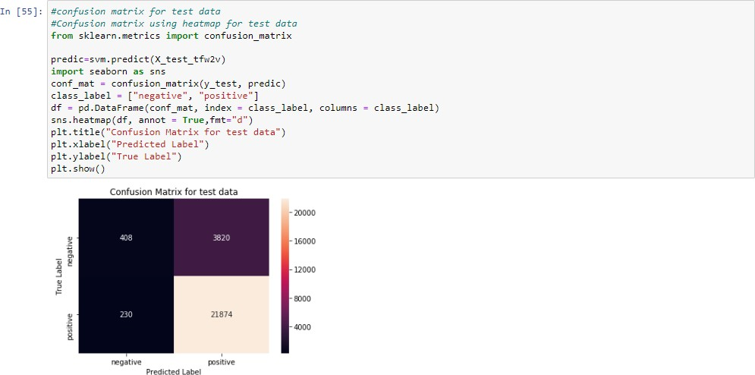
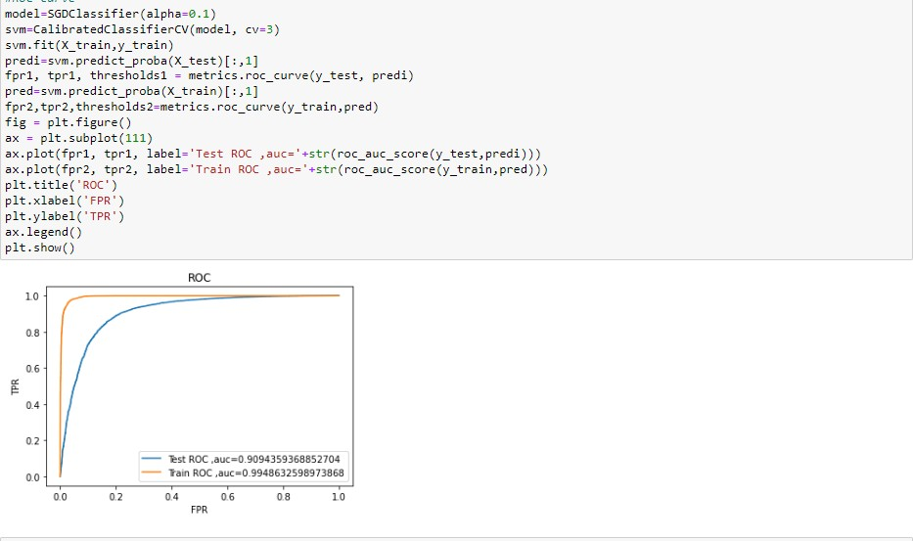
SVM (Support Vector Machines)

Slide 14
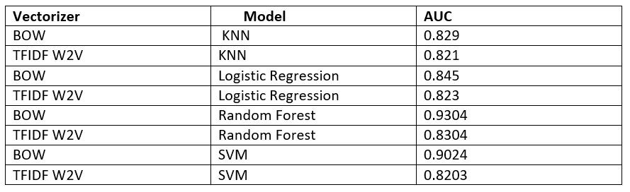
Results
Random Forest Model:
Achieved the highest AUC scores for both BOW and TFIDF W2V vectorization techniques.
AUC score of 0.9304 for BOW and 0.8304 for TFIDF W2V.
Demonstrated exceptional performance in distinguishing between the two classes.
Strong ability to capture complex relationships and patterns within the data.
Logistic Regression Model:
Showcased good performance with AUC scores of 0.845 for BOW and 0.823 for TFIDF W2V.
BOW vectorization method, reflecting word occurrences, fit well with the linear model of logistic regression.
Random Forest outperformed Logistic Regression in both cases.
KNN Model:
Obtained AUC scores of 0.829 for BOW and 0.821 for TFIDF W2V, indicating decent performance.
SVM Model:
Performed reasonably well with AUC scores of 0.9024 for BOW and 0.8203 for TFIDF W2V.

Slide 15

Conclusion
Random Forest model demonstrated the highest discriminative power, achieving the best performance among the evaluated models.
Logistic Regression also performed well, while KNN and SVM exhibited slightly lower performance.
The choice of vectorization technique can influence model performance, with BOW yielding higher AUC scores overall compared to TFIDF W2V.
These evaluation findings offer insightful information about the advantages and disadvantages of each approach, helping decision-makers choose the best model for a specific task.

